Slide 1
Java 4 WEB
Lesson 8 Functional Programming

Slide 2
Lesson goals
Functional programming
Functional interface
Lambda’s

Slide 3
Functional programming paradigm
It is a style of building the structure and elements of computer programs — that treats computation as the evaluation of mathematical functions and avoids changing-state and mutable data
In functional code, the output value of a function depends only on the arguments that are input to the function.
Notes:
As long as we call function with the same arguments, it always returns the same result

Slide 4
Lambda
Lambda – a piece of code
Anonymous class
Runnable r1 = new Runnable() {
@Override
public void run() {
System.out.print(“Hello");
}
};
Lambda
Runnable r2 = () -> { System.out.print(“Hello"); };
Notes:
In Java we work with two types of value primitive values and references to objects. Both can be used as the arguments of a method
If we want to pass some piece of code to a method, we have to wrap it in an object But since Java 8, we can pass that piece of code directly through the use of a lambda expression.
Lambda expressions let you express instances of single-method classes more compactly.
Recall that lambda expressions rely on the notion of deferred execution.
Deferred execution means that code is specified now but runs later. In this case, later is when the print() method calls it. Even though the execution is deferred, the compiler will still validate that the code syntax is properly formed

Slide 5
Interface
class Lion implements Walk { public boolean isQuadruped() { return true; } public double getMaxSpeed() { return 100; } }
interface Walk { boolean isQuadruped(); double getMaxSpeed(); }
Notes:
Defines a set of public abstract methods to be implemented
A class may implement multiple interfaces
May extend other interfaces (can not extend a class and vice versa)
May contain public static final constant values, public static methods, and public default methods.

Slide 6
Functional interface
has exactly one abstract method
can contain unlimited count of default methods
can contain unlimited count of static methods
can re-declare Object methods

Slide 7

Functional interface
@FunctionalInterface interface Speakable { String say(); }

Slide 8
Functional interface as well
@FunctionalInterface interface Speakable { String say(); int hashCode(); // redeclare Object method static void someStatic() { System.out.println("In static..."); } default void someDefault() { System.out.println("In default..."); } }

Slide 9
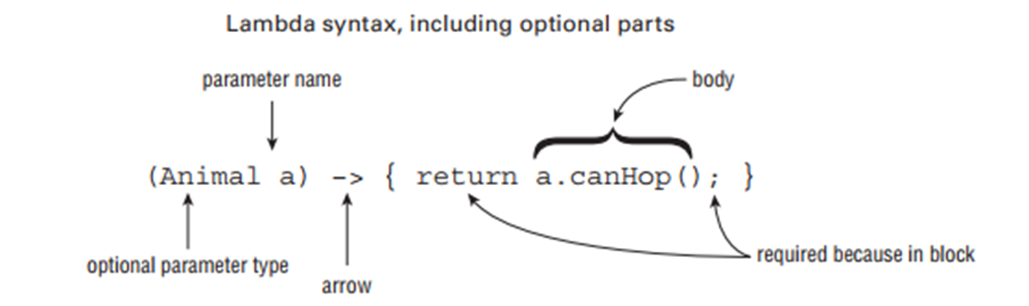
Lambda
Notes:
The signature of the abstract method of a functional interface provides the signature of a lambda expression (this signature is called a functional descriptor)

Slide 10
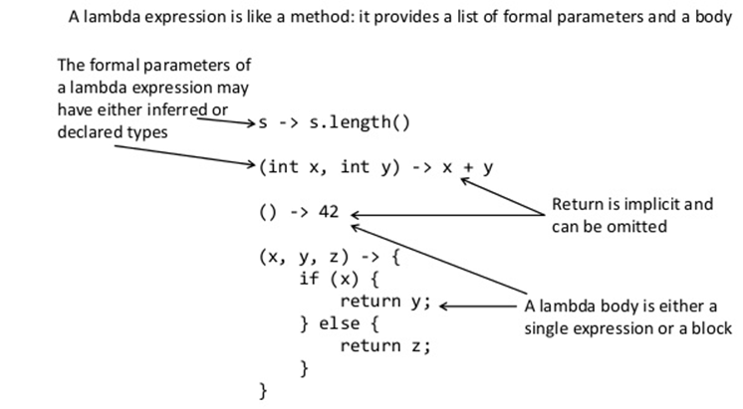
Lambda expression anatomy

Slide 11
Lambda and Anonymous class difference
this keyword behavior is different
Default methods accesibility
Different compiled bytecode
Notes:
1. For an anonymous class, this keyword resolves to the anonymous class itself. For a lambda expression - class where the lambda is written.
2. Default methods of a functional interface cannot be accessed from within lambda expressions. Anonymous classes can.
3. Anonymous classes are compiled into inner classes. Lambda expressions are converted into private static (in some cases) methods of their enclosing class and, using the invokedynamic instruction.

Slide 12
Lambda declaration
Lambda expressions don't contain the information about which functional interface are implementing.
interface Searchable { boolean test(Car car); } interface Saleable { boolean approve(Car car); } Searchable s1 = c -> c.getCostUSD() > 20000; Saleable s2 = c -> c.getCostUSD() > 20000;
Notes:
The type of the expression is deduced from the context in which the lambda is used. This type is called target type.
The contexts where the target type of a lambda expression can be inferred include an assignment, method or constructor arguments, and a cast expression.

Slide 13
Lambda vs Anonymous class
@FunctionalInterface interface Translator { String translate(String input); }
public static void main(String[] args) { Translator oldSchool = new Translator() { @Override public String translate(String input) { return input.toLowerCase(); } }; Translator newSchool = input -> input.toLowerCase(); Translator newerSchool = String::toLowerCase; }

Slide 14
Accessibility and
Lambda expressions can access
static variables
instance variables
effectively final method parameters
effectively final local variables
does not allow checked exceptions

Slide 15
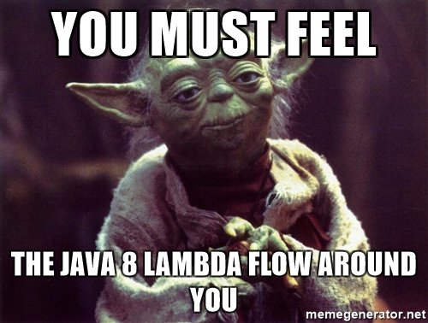
Effectively final
If you could add the final modifier to a variable and the code still compiles, it was “effectively final

Slide 16
Accessibility
static void test(int effectivelyFinalArgument,
int notEffectivelyFinalArgument) { Entity entity = new Entity(); if (effectivelyFinalArgument > 1) { notEffectivelyFinalArgument = 1; } int effectiveFinalLocalId = 3; int notEffectiveFinalLocalId = 4; if (notEffectiveFinalLocalId > 1) { notEffectiveFinalLocalId = 5; } speak(() -> STATIC_ID); // 1 speak(() -> entity.instanceId); // 2 speak(() -> effectiveFinalLocalId); // 3 speak(() -> notEffectiveFinalLocalId); // fail to compile speak(() -> effectivelyFinalArgument); // 1 speak(() -> notEffectivelyFinalArgument); // argument value }
@FunctionalInterface interface Identifiable { int getId(); }
class Entity { private static int STATIC_ID = 1; private int instanceId = 2; public static void main(String[] args) { test(4, 5); } static void speak(Identifiable identifiable) { System.out.println(identifiable.getId()); }
}
Notes:
Lambda expressions can access
static variables
instance variables
effectively final method parameters
effectively final local variables
does not allow checked exceptions

Slide 17
Method reference
You use lambda expressions to create anonymous methods. Sometimes, however, a lambda expression does nothing but call an existing method. In those cases, it's often clearer to refer to the existing method by name.
A method reference is the shorthand syntax to a lambda expression that executes just one method.
Notes:
Instead of using
AN ANONYMOUS CLASS
you can use
A LAMBDA EXPRESSION
And if this just calls one method, you can use
A METHOD REFERENCE

Slide 18
Method reference
@FunctionalInterface public interface Comparator<T> { int compare(T o1, T o2); } public static class Person { private LocalDate birthday; public static int compareByAge(Person a, Person b) { return a.birthday.compareTo(b.birthday); } } public static void main(String[] args) { Person[] people = {new Person(), new Person()}; Arrays.sort(people, (a, b) -> Person.compareByAge(a, b)); // lambda Arrays.sort(people, Person::compareByAge); // method reference }

Slide 19
Method reference
Reference to a static method ContainingClass::staticMethodName
Reference to an instance method of a particular object containingObject::instanceMethodName
Reference to an instance method of an arbitrary object of a particular type ContainingType::methodName
Reference to a constructor ClassName::new

Slide 20
Static method reference
class Numbers { public static boolean isMoreThanFifty(int n1, int n2) { return (n1 + n2) > 50; } public static List<Integer> findNumbers( List<Integer> integers,
BiPredicate<Integer, Integer> predicate
) { List<Integer> newList = new ArrayList<>(); for (Integer i : l) { if (p.test(i, i + 10)) { newList.add(i); } } return newList; } }
List<Integer> list = Arrays.asList(12, 5, 45, 18, 33, 24, 40); // Using an anonymous class findNumbers(list, new BiPredicate<Integer, Integer>() { public boolean test(Integer i1, Integer i2) { return Numbers.isMoreThanFifty(i1, i2); } }); // Using a lambda expression findNumbers(list, (i1, i2) -> Numbers.isMoreThanFifty(i1, i2)); // Using a method reference findNumbers(list, Numbers::isMoreThanFifty);

Slide 21
Reference instance method of an object
public static void main(String[] args) { Mechanic mechanic = new Mechanic(); Car car = new Car(); // Using an anonymous class execute(car, new Consumer<Car>() { public void accept(Car c) { mechanic.fix(c); } }); // Using a lambda expression execute(car, c -> mechanic.fix(c)); // Using a method reference execute(car, mechanic::fix); } static void execute(Car car, Consumer<Car> c) { c.accept(car); }
class Car { int id; //... }
class Mechanic { public void fix(Car c) { System.out.println("Fixing car " + c.id); } }

Slide 22
Instance method of object of a particular type
public static void main(String[] args) { List<Shipment> l = new ArrayList<>(); // Using an anonymous class calculateOnShipments(l, new Function<Shipment, Double>() { public Double apply(Shipment s) { // The object return s.calculateWeight(); // The method } }); // Using a lambda expression calculateOnShipments(l, s -> s.calculateWeight()); // Using a method reference calculateOnShipments(l, Shipment::calculateWeight); } public static List<Double> calculateOnShipments(List<Shipment> l, Function<Shipment, Double> f) { List<Double> results = new ArrayList<>(); l.forEach(s -> results.add(f.apply(s))); return results; }
class Shipment { public double calculateWeight() { double weight = 0; // … Calculate weight return weight; } }

Slide 23
Reference to a constructor
// Using an anonymous class Supplier<List<String>> s = new Supplier() { public List<String> get() { return new ArrayList<String>(); } }; List<String> l = s.get();
// Using a lambda expression Supplier<List<String>> s = () -> new ArrayList<String>(); List<String> l = s.get();
// Using a method reference Supplier<List<String>> s = ArrayList::new; List<String> l = s.get();

Slide 24
Common functional interfaces
Functional Interface | #Parameters | Return Type | Single Abstract Method
Supplier<T> | 0 | T | get
Consumer<T> | 1 | void | accept
Predicate<T> | 1 | boolean | test
Function<T, R> | 1 | R | apply

Slide 25
Supplier
@FunctionalInterface interface Supplier<T> { T get(); }
class Beer{ //... }
public static void main(String[] args) { Supplier<Beer> supplier1 = () -> new Beer(); Supplier<Beer> supplier2 = Beer::new;
Supplier<Beer> supplier3 = new Supplier<Beer>() {
…. println(supplier1.get()); // Beer@123ec81 println(supplier1.get()); // Beer@cbcfc0 println(supplier2.get()); // Beer@1184fc6 println(supplier2.get()); // Beer@1496d9f
println(supplier1); // Main$$Lambda$1/30852576@3279cf println(supplier2); // Main$$Lambda$1/30852576@3279cf }
Notes:
$$ - means that the class doesn’t exist in a class file on the file system

Slide 26
Consumer
@FunctionalInterface interface Consumer<T> { void accept(T t); }
class Beer{ //... }
public static void main(String[] args) { Supplier<Beer> supplier1 = () -> new Beer(); Supplier<Beer> supplier2 = Beer::new; Consumer<Beer> consumer1 = beer -> System.out.println(beer); Consumer<Beer> consumer2 = System.out::println; consumer1.accept(supplier1.get()); // Beer@14c966a consumer1.accept(supplier2.get()); // Beer@14d3709 consumer2.accept(supplier1.get()); // Beer@50df2e consumer2.accept(supplier2.get()); // Beer@181eb93 }

Slide 27
Predicate
@FunctionalInterface interface Predicate<T> { boolean test(T t); }
class Beer { //... boolean isTasty() { return false; } }
public static void main(String[] args) { Predicate<Beer> predicate1 = beer -> beer.isTasty(); Predicate<Beer> predicate2 = Beer::isTasty; Supplier<Beer> supplier = Beer::new;
println(predicate1.test(supplier.get())); // false
println(predicate2.test(supplier.get())); // false }

Slide 28
Function
@FunctionalInterface interface Function<T, R> { R apply(T t); }
class Water { //... }
class Wine { Wine(Water water) { // magic } }
public static void main(String[] args) { Function<Water, Wine> god1 = water -> new Wine(water); Function<Water, Wine> god2 = Wine::new; println(god1.apply(new Water())); // Wine@1eba861 println(god2.apply(new Water())); // Wine@1480cf9 }

Slide 29
Own functional interface
@FunctionalInterface interface QuadFunction<T, U, V, W, R> { R apply(T t, U u, V v, W w); } public static void main(String[] args) {
QuadFunction<Integer, Integer, Integer, Integer, Integer>
quadFunction = (a, b, c, d) -> a * b + c * d; System.out.println(quadFunction.apply(1, 2, 3, 4)); // 14 }

Slide 30
What to choose?
What functional interface would you use in these next situations?
Returns a String without taking any parameters
Returns a Boolean and takes a String
Returns an Integer and takes String
Returns nothing, takes Integer

Slide 31
Literature
Lambda Expressions
Lambda Expressions - 2
Lambda QuickStart
Method Reference Expressions
Lambda's (habrahabr)
Lambda's best practices

Slide 32
Homework Task 1
Implement all methods from interface CollectionOperations according to Java docs that describe each method (do not use Java Stream API).
Implement unit tests for every method
Add examples of using all methods (at least two of three):
By anonymous classes
By lambdas
By method references

Slide 33
public interface CollectionOperations { <E> List<E> fill(Supplier<E> producer, int count); <E> List<E> filter(List<E> elements, Predicate<E> filter); <E> boolean anyMatch(List<E> elements, Predicate<E> predicate); <E> boolean allMatch(List<E> elements, Predicate<E> predicate); <E> boolean noneMatch(List<E> elements, Predicate<E> predicate); <T, R> List<R> map(List<T> elements, Function<T, R> mappingFunction); <E> Optional<E> max(List<E> elements, Comparator<E> comparator); <E> Optional<E> min(List<E> elements, Comparator<E> comparator); <E> List<E> distinct(List<E> elements); <E> void forEach(List<E> elements, Consumer<E> consumer); <E> Optional<E> reduce(List<E> elements, BinaryOperator<E> accumulator); <E> E reduce(E seed, List<E> elements, BinaryOperator<E> accumulator); <E> Map<Boolean, List<E>> partitionBy(List<E> elements, Predicate<E> predicate); <T, K> Map<K, List<T>> groupBy(List<T> elements, Function<T, K> classifier); <T, K, U> Map<K, U> toMap(
List<T> elements,
Function<T, K> keyFunction,
Function<T, U> valueFunction,
BinaryOperator<U> mergeFunction
); }

Slide 34
/** * creates list of object * @param producer - creates one object should be added to list * @param count - number of objects should be added to list */ <E> List<E> fill(Supplier<E> producer, int count);
/** * filters list by some rule * @param elements - list of objects that should be filtered * @param filter - rule that should be used for filtering */ <E> List<E> filter(List<E> elements, Predicate<E> filter);
/** * returns true if at least one of objects from list match the rule * @param elements - list of objects that should be verified * @param predicate - rule should match object(s) from list */ <E> boolean anyMatch(List<E> elements, Predicate<E> predicate);
/** * returns true if all objects from list match the rule * @param elements - list of objects that should be verified * @param predicate - rule should match object(s) from list */ <E> boolean allMatch(List<E> elements, Predicate<E> predicate);

Slide 35
/**​ * returns false if at least one of objects from list match the rule​ * @param elements - list of objects that should be verified​ * @param predicate - matching rule should be applied to each object from list​ */​ <E> boolean noneMatch(List<E> elements, Predicate<E> predicate);
/** * transforms all elements in list * @param elements - list of objects should be transformed * @param mappingFunction - transformation rule */ <T, R> List<R> map(List<T> elements, Function<T, R> mappingFunction);
/** * returns maximum value from list if exists, {@link Optional#empty()} otherwise * @param elements - list of elements * @param comparator - comparator that implements comparing rules for current list of objects */ <E> Optional<E> max(List<E> elements, Comparator<E> comparator);
/** * returns minimum value from list if exists, {@link Optional#empty()} otherwise * @param elements - list of elements * @param comparator - comparator that implements comparing rules for current list of objects */ <E> Optional<E> min(List<E> elements, Comparator<E> comparator);

Slide 36
/** * returns list of unique object from original list (List should be returned, not Set) * @param elements - list of elements */ <E> List<E> distinct(List<E> elements);
/** * applies some action to each object from list (prints into console, adds to another list, etc) * @param elements - list of elements */ <E> void forEach(List<E> elements, Consumer<E> consumer);
/** * reduces all objects from list by some rule (for example calculates sum of all elements in the list) * @param elements - list of elements * @param accumulator - function to combine two values (for example: addition, subtraction, multiplication) */ <E> Optional<E> reduce(List<E> elements, BinaryOperator<E> accumulator);
/** * the same as {@link #reduce(List, BinaryOperator)} but with specified initial value: seed * @param elements - list of elements * @param accumulator - function to combine two values (for example: addition, subtraction, multiplication) * @param seed - the identity value for the accumulating function */ <E> E reduce(E seed, List<E> elements, BinaryOperator<E> accumulator);

Slide 37
/** * splits all elements into two group: 1 - match specified predicate, 2 - do not match predicate * @param elements - list of elements * @param predicate - a predicate used for classifying input elements */ <E> Map<Boolean, List<E>> partitionBy(List<E> elements, Predicate<E> predicate);
/** * groups elements according to a classification function (for example: groups tasks by category name) * @param elements - list of object should be grouped by specified classifier * @param classifier - a classifier function mapping input elements to keys */ <T, K> Map<K, List<T>> groupBy(List<T> elements, Function<T, K> classifier);
/** * Accumulates elements into a Map whose keys and values are the result of applying the provided * mapping functions to the input elements. * @param elements - list of object should be grouped by specified classifier * @param keyFunction - a mapping function to produce keys * @param valueFunction - a mapping function to produce values * @param mergeFunction - merge function, used to resolve collisions between values associated with the same key */ <T, K, U> Map<K, U> toMap(List<T> elements, Function<T, K> keyFunction, Function<T, U> valueFunction, BinaryOperator<U> mergeFunction);

